Slide 1
Career Readiness, CTE, 21st Century Skills, & the Common Core: A World of Opportunity for California Schools
Educating for Careers Pre-Conference
Sacramento, California
March 2, 2014
David Militzer Rebecca Dedmond, Ph.D.
Education Programs Consultant Director, Freshman Transition Initiative
California Department of Education George Washington University
Dan Blake Carolyn Zachry
Director, Innovation & Partnerships Administrator, College & Career Transition
Sonoma County Office of Education California Department of Education

Slide 2
21st Century Skills
Dan Blake
Sonoma County Office of Education

Slide 3
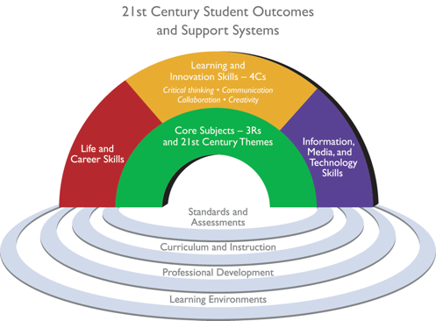

Slide 4
21st Century Skills Framework
Critical 21st Century Skills Areas
Core Subjects & 21st Century Themes
The 4 C’s
Critical Thinking
Creativity
Collaboration
Communication
Life & Career Skills
Information, Media, & Technology Skills

Slide 5
Interdisciplinary Themes
21st Century Themes
Global Awareness
Financial Literacy
Civic Literacy
Health Literacy
Environ-
mental
Literacy

Slide 6
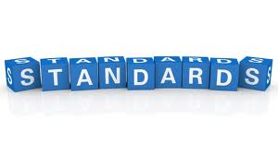
21st Century Skills & Themes Applied to…
Standards & Assessments
Curriculum & Instruction
Professional Development
Learning Environments

Slide 7
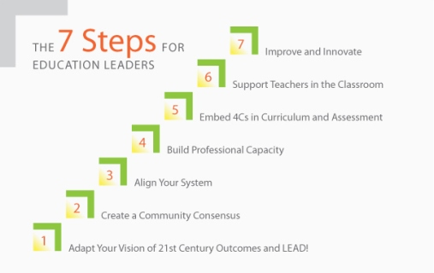
EdLeader 21 7 Steps

Slide 8
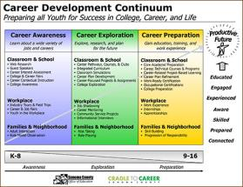
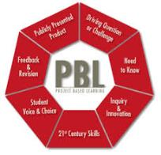
Current Efforts in Sonoma County…

Slide 9
Website Addresses
www.scoe.org
www.c2csonomacounty.org
www.ieSonoma.org
www.MakerEd.org
www.connectedmakers.org
www.edcampsonoma.org
www.edleader21.com
www.leadershipanddesign.org

Slide 10
Transition Initiative
Rebecca Dedmond
George Washington University

Slide 11
Comprehensive Guidance Standards frame a course for students filled with explorations and experiences
Personal/Social Development
Educational Achievement
Career and Life Skills

Slide 12
High School Transition Standards
Cultivate student’s sense of belonging
Encourage ownership of learning (create PLP)
Support the ability to make good choices during a time of changes and challenges
Provide a foundation for a self sufficient future
www.freshmantransition.org
* Based on research-based best practices, developmental psychology, and learning theory

Slide 13
Middle Level Standards
Help students
navigate their way
into adolescence.

Slide 14
Personal/Social Development
Students will:
1.Develop a strong, positive self concept
2. Develop positive, meaningful relationships
3. Demonstrate effective communication skills
4. Learn the benefits of having a cooperative spirit
5. Work well in teams
6. Appreciate cultural experiences
7. Cope with adversity
Notes:
What is the project about?
Define the goal of this project
Is it similar to projects in the past or is it a new effort?
Define the scope of this project
Is it an independent project or is it related to other projects?
* Note that this slide is not necessary for weekly status meetings

Slide 15
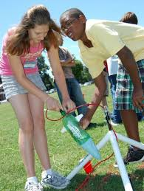
Educational Achievement
Students will:
8. Develop organizational skills
9. Discover how they learn best
10. Apply learning skills to academic tasks

Slide 16
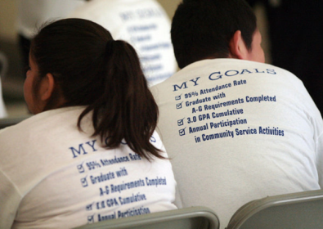
Career and Life Skills
Students will:
11.Explore skills, interests, & aptitudes
12. Apply strategies to solve problems & make decisions
13. Set goals, make a plan to reach those goals & carry out
the plan
Notes:
What is the project about?
Define the goal of this project
Is it similar to projects in the past or is it a new effort?
Define the scope of this project
Is it an independent project or is it related to other projects?
* Note that this slide is not necessary for weekly status meetings

Slide 17
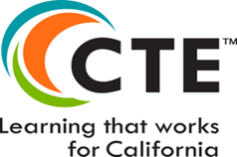
Standards for Career Ready Practice
Carolyn Zachry
California Department of Education

Slide 18
Notes:
Duplicate this slide as necessary if there is more than one issue.
This and related slides can be moved to the appendix or hidden if necessary.

Slide 19
Career Readiness Learning Continuum
Employment
Industry Specific
licensure and certifications
Standards for Career Ready Practice
What ALL students need to know and understand.
Industry Sector Anchor
Knowledge and Skills common to a particular Industry Sector
Pathway
Knowledge and Skills necessary for success in a CTE pathway
19
Notes:
More info on CCTC
This pyramid reflects the structure of the MCS and where students can go beyond this document.
The first three level are the structure of the MCS. The top two reflect the additional expectations employers will have for people following through in their pathway.
The standards for career ready practice are what all high school students need to be employable and college ready.

Slide 20
Standards for Career Ready Practice
Adapted from the National Common Career Technical Core
Align with the Skills for the 21st Century
Describe the fundamental knowledge and skills needed to be ready for careers AND college
Not exclusive to a career pathway, CTE program of study, a particular discipline, or grade level
Notes:
The Standards for Career Ready Practice are adapted from the National Common Career Technical Core; over 42 states were involved in the development of these practices. The twelve Standards for Career Ready Practice reflect the expectations from business and industry, labor, community, and education representatives from over 40 participating states and align with the CTE anchor standards.
These new Standards for Career Ready Practice were adopted for California and based on the “Career Ready Practices” adopted by the Common Career Technical (CCTC). The CCTC practices are posted at: http://www.careertech.org/
These were derived from the Secretary’s Commission on Achieving Necessary Skills (SCANS) Report first published in the 1990’s.

Slide 21
Standards for Career Ready Practice
Increase in complexity and expectation as students advance through a program of study
Are taught and reinforced in all career exploration or career preparation programs, or integrated into core curriculum
For ALL students, not just CTE students
Notes:
The Standards for Career Ready Practice can be integrated with a course or incorporated into several courses over multiple school years (grades seven through twelve). The practices are expectations for all students, whether they are enrolled in a CTE program or following a more generalized course sequence. It is expected that all students who exit high school will be proficient in these practices.

Slide 22
Standards for Career Ready Practice
Apply appropriate technical skills & academic knowledge
Communicate clearly, effectively, and with reason
Develop an education & career plan aligned to personal goals
Apply technology to enhance productivity
Utilize critical thinking to make sense of problems and persevere in solving them
Practice personal health & understand financial literacy
Notes:
Standards for Career Ready Practice: reference pages 11 & 12 of the CTE Model Curriculum Standards Executive Summary.
Cue audience to pull out/ or pass out Handout module 1-#4: Standards for Career Ready Practice
These are for ALL students, not just CTE students!
This is the foundation that all students need to be ready for careers AND college. We will take a closer look at these in Module 2.

Slide 23
Standards for Career Ready Practice (continued)
Act as a responsible citizen in the workplace and the community
Model integrity, ethical leadership, and effective management
Work productively in teams while using cultural/global competence
Demonstrate creativity and innovation
Employ valid and reliable research strategies
Understand the environmental, social, and economic impacts of decisions
Notes:
They are adapted from the National Common Career Technical Core and funded by the National Association of State Directors of CTE Consortium; over 42 states were involved in the development of these practices. This was a national effort to make certain ALL students get this information. These are the updated version of the 21st SCANS skills. Discuss these standards in depth.

Slide 24
Standards for Career Ready Practice Example
3. Develop an education and career plan
aligned to personal goals.
Career-ready individuals take personal ownership of their own educational and career goals and manage their individual plan to attain these goals. They recognize the value of each step in the educational and experiential process, and that nearly all career paths require ongoing education and experience to adapt to practices, procedures, and expectations of an ever changing work environment. They seek counselors, mentors, and other experts to assist in the planning and execution of education and career plans.

Slide 25
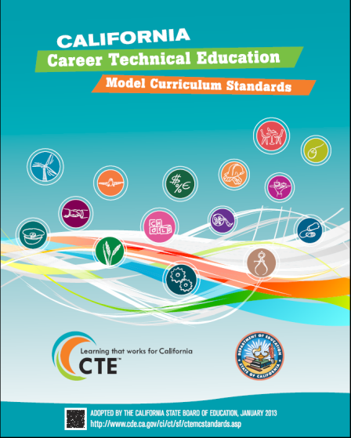
The new model curriculum standards are available online at:
http://www.cde.ca.gov/ci/ct/sf/ctemcstandards.asp
Notes:
Speaker should emphasize the convenience of the linked resource online, which takes viewers directly to Industry Sectors.
QR code takes smartphone users, tablets, etc. directly to the webpage.
Announce that the MCS Introduction is available online

Slide 26
Resources
Career Technical Education Model Curriculum Standards: http://www.cde.ca.gov/ci/ct/sf/ctemcstandards.asp
Common Career Technical Education Core: http://www.careertech.org/career-technical-education/cctc/
Information about the common core: http://www.corestandards.org/
Full text of the Common Core State Standards: http://www.scoe.net/castandards/index.html
Information about the common core including implementation timelines:http://www.cde.ca.gov/ci/cc/
SBAC information: http://www.smarterbalanced.org/
Achieve: http://www.achieve.org/
Curriculum development and model lessons CTE Online: http://www.cteonline.org
California Career Resource Network (CalCRN): http://www.californiacareers.info

Slide 27
Contact Information
David Militzer Rebecca Dedmond
dmilitzer@cde.ca.gov rdedmond@gwu.edu
916-323-5146 703-549-6935
Dan Blake Carolyn Zachry
dblake@scoe.org czachry@cde.ca.gov
707-524-2780 916-323-5042

